Slide 1
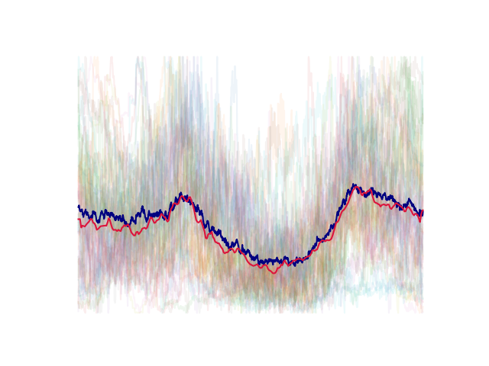
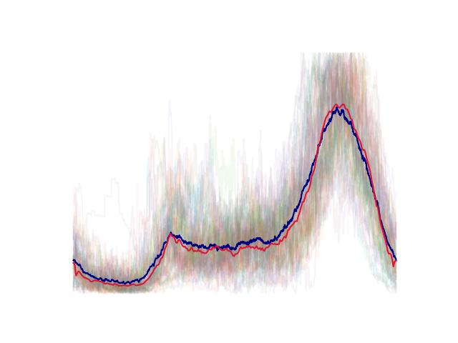
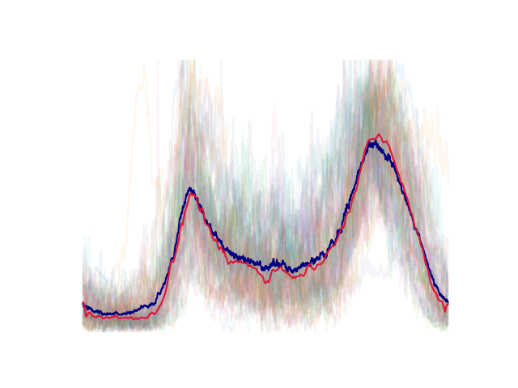
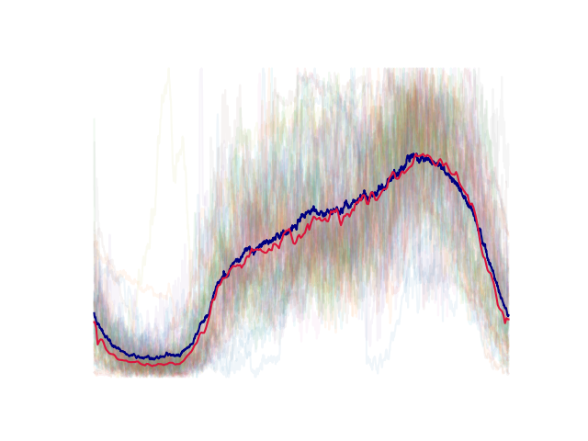
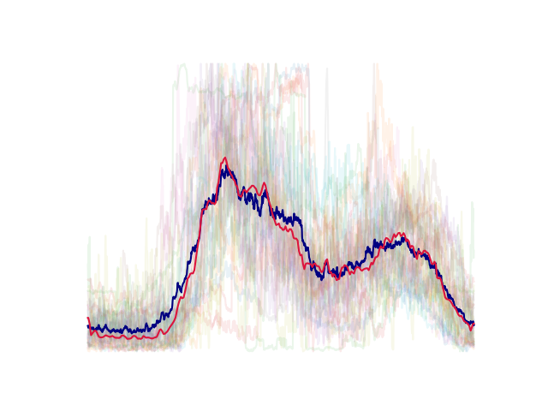
Exploring daily load profile clustering
with Convolutional Autoencoders
Members : Chen Ang
Fu Quanzhi

Slide 2
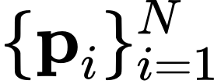
Problem formulation
Given: Average daily load profiles of $N=460$ residents, all normalized to [0, 1].
TODO: Put some profiles here

Slide 3
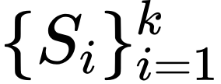
Problem formulation
Given: Average daily load profiles of $N=460$ residents, all normalized to [0, 1].
Goal: Find a k-partition of the profiles such that similar profiles are clustered into the same set.

Slide 4
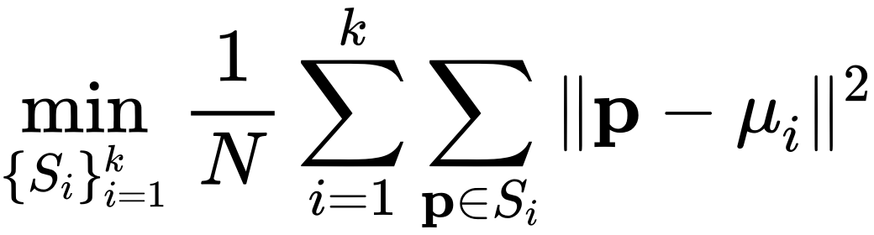
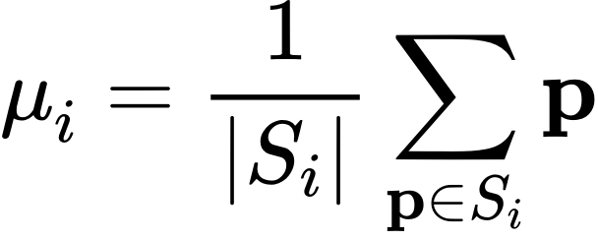
Problem formulation
Given: Average daily load profiles of $N=460$ residents, all normalized to [0, 1].
Goal: Find a k-partition of the profiles such that similar profiles are clustered into the same set.
How to measure similarity?
K-means algorithm?

Slide 5
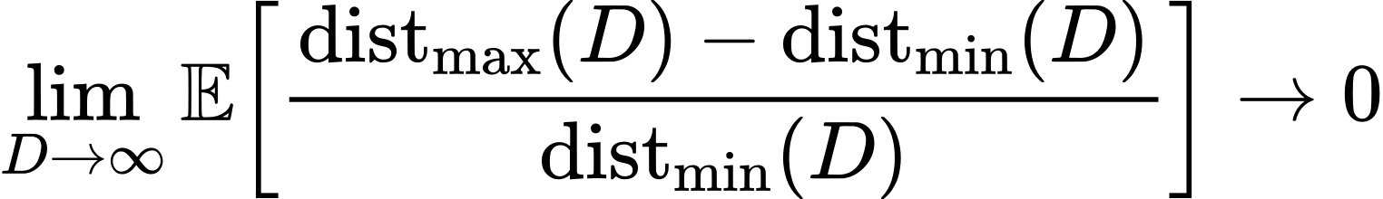
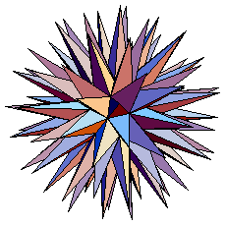
Curse of dimensionality
(Beyer, Goldstein, Ramakrishnan, Shaft)
high dimensionality
(in our case, D = 1440)

Slide 6
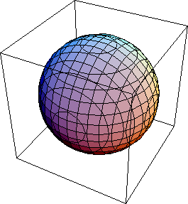
Curse of dimensionality
(Beyer, Goldstein, Ramakrishnan, Shaft)
Dimension reduction
high dimensionality
(in our case, D = 1440)
low dimensionality
(d = 3)

Slide 7
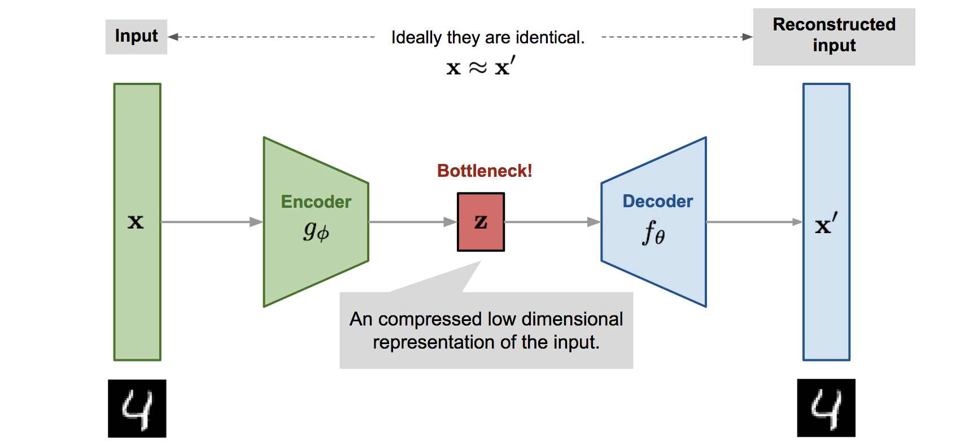
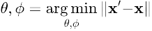
Autoencoder
low dimensional latent variable.
A generic autoencoder

Slide 8
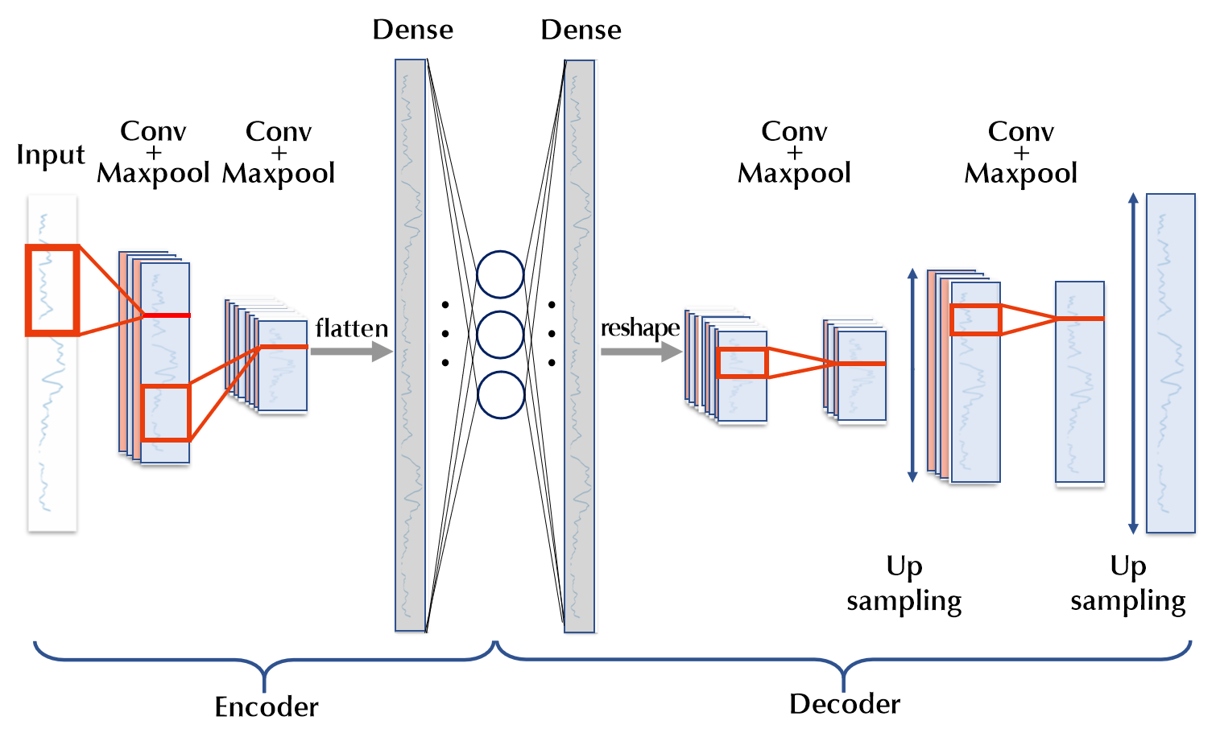
Arichitecture

Slide 9
TODO: Autoencoders for image classification (stress: high-dim problem)

Slide 10
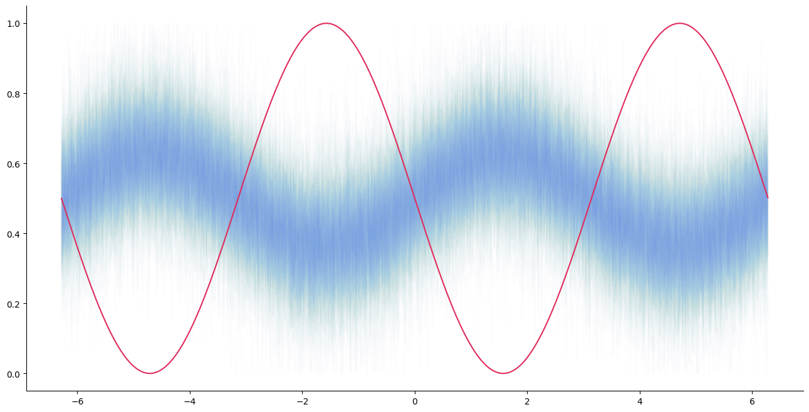
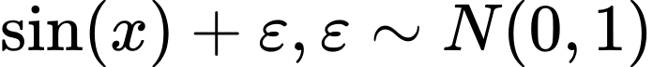
Experiment with sinusiodals
Cluster #1 (N = 100):
Cluster #2 (N = 1):

Slide 11
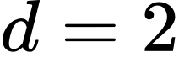
Success rates of clustering:
Direct K-means vs. Autoencoder ( )

Slide 12
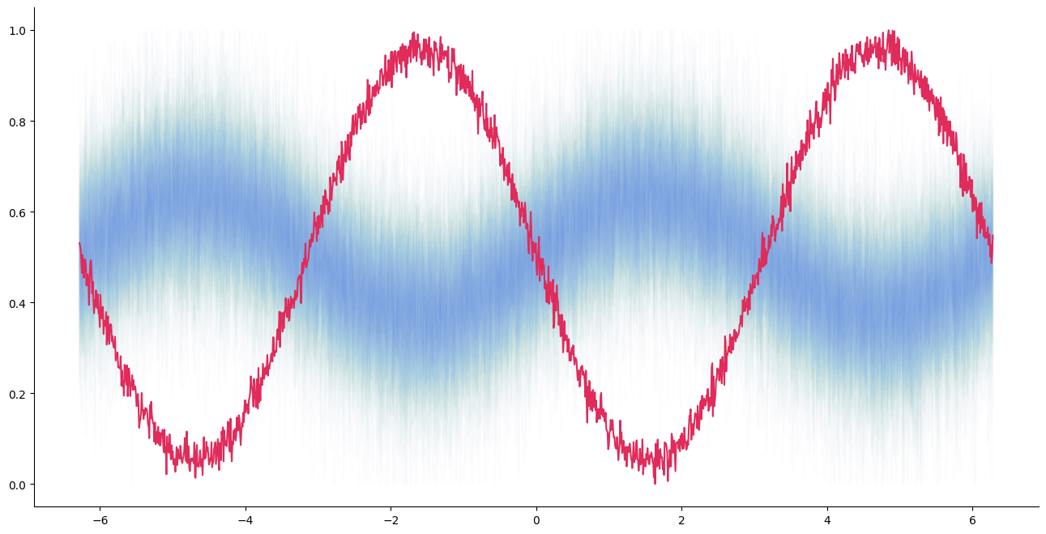
Success rates of clustering:
Direct K-means vs. Autoencoder ( )

Slide 13
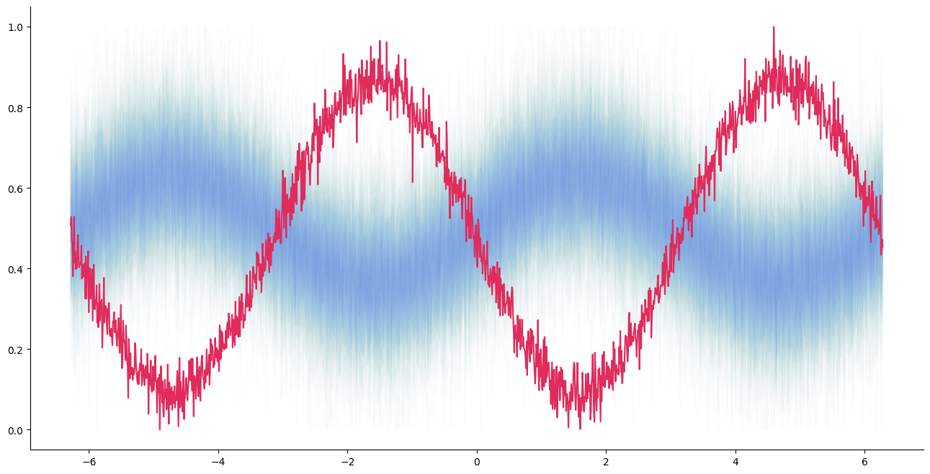
Success rates of clustering:
Direct K-means vs. Autoencoder ( )

Slide 14
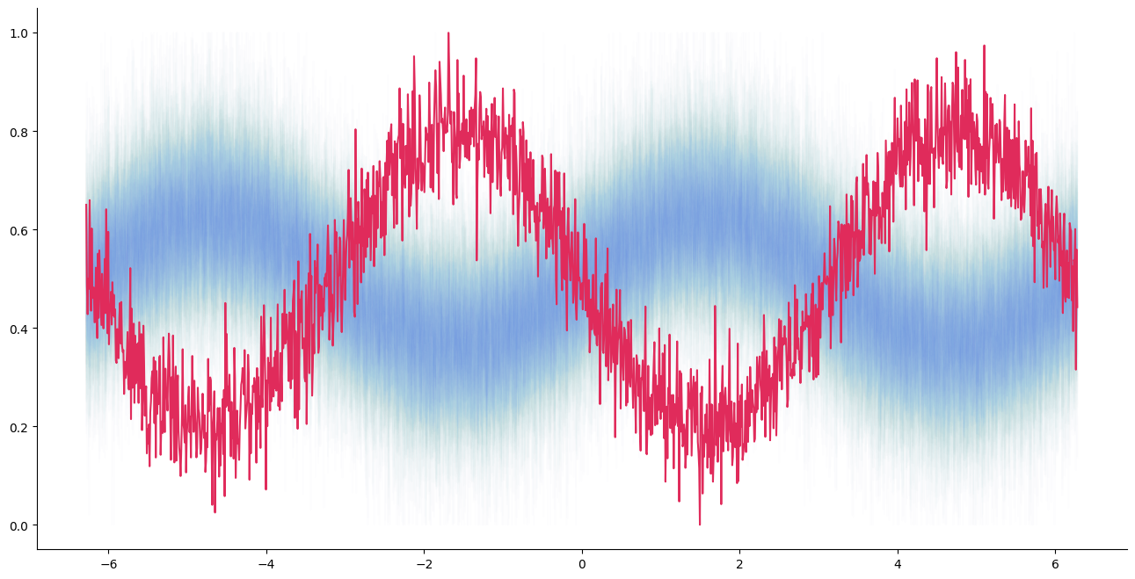
Success rates of clustering:
Direct K-means vs. Autoencoder ( )

Slide 15
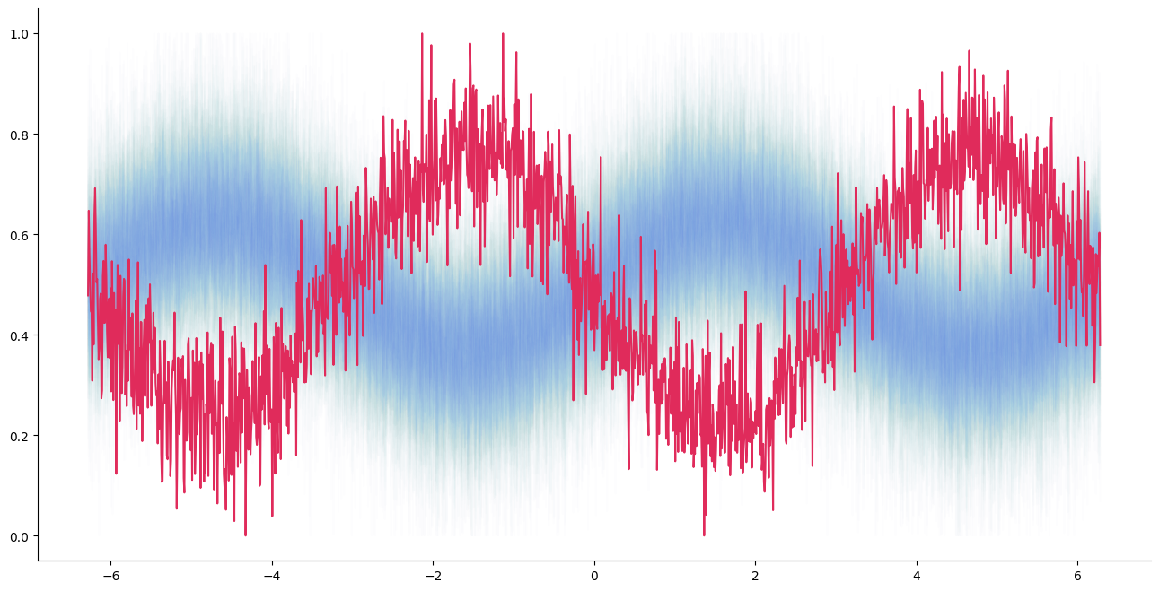
Success rates of clustering:
Direct K-means vs. Autoencoder ( )

Slide 16
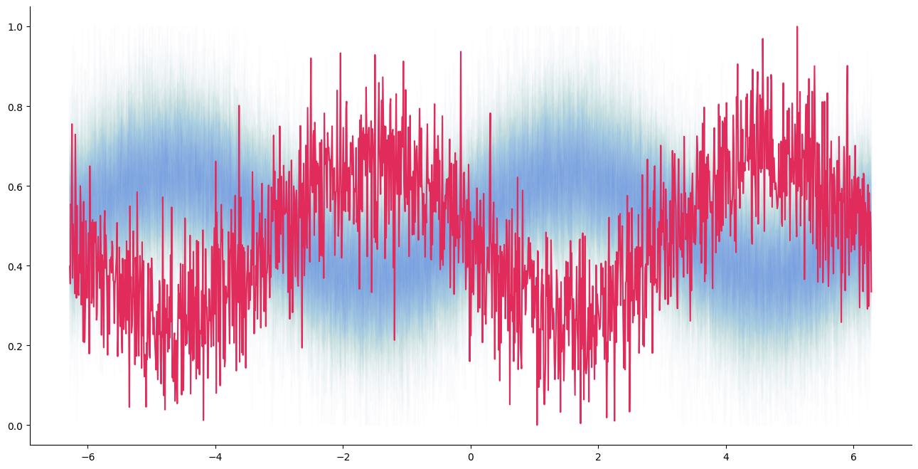
Success rates of clustering:
Direct K-means vs. Autoencoder ( )

Slide 17
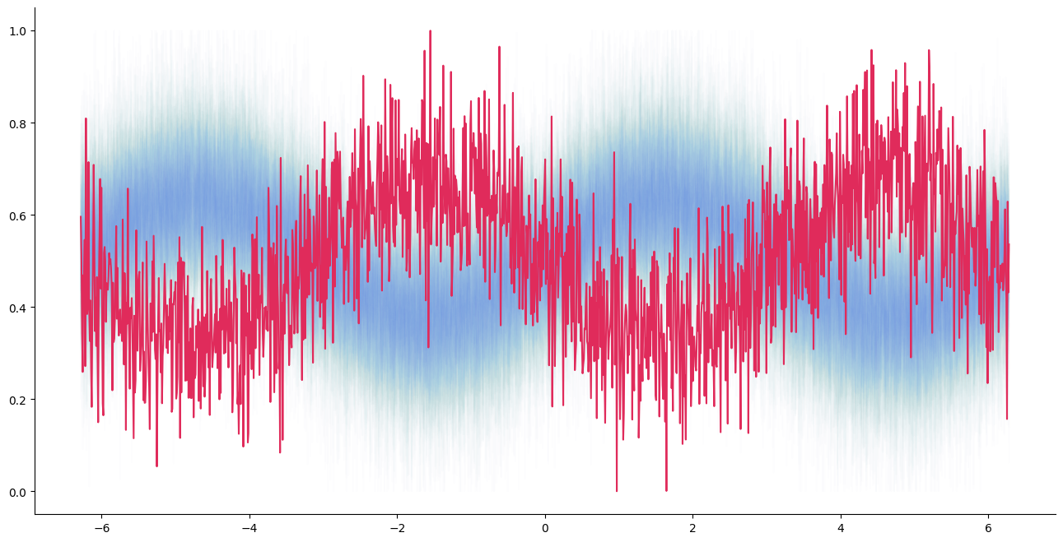
Success rates of clustering:
Direct K-means vs. Autoencoder ( )

Slide 18
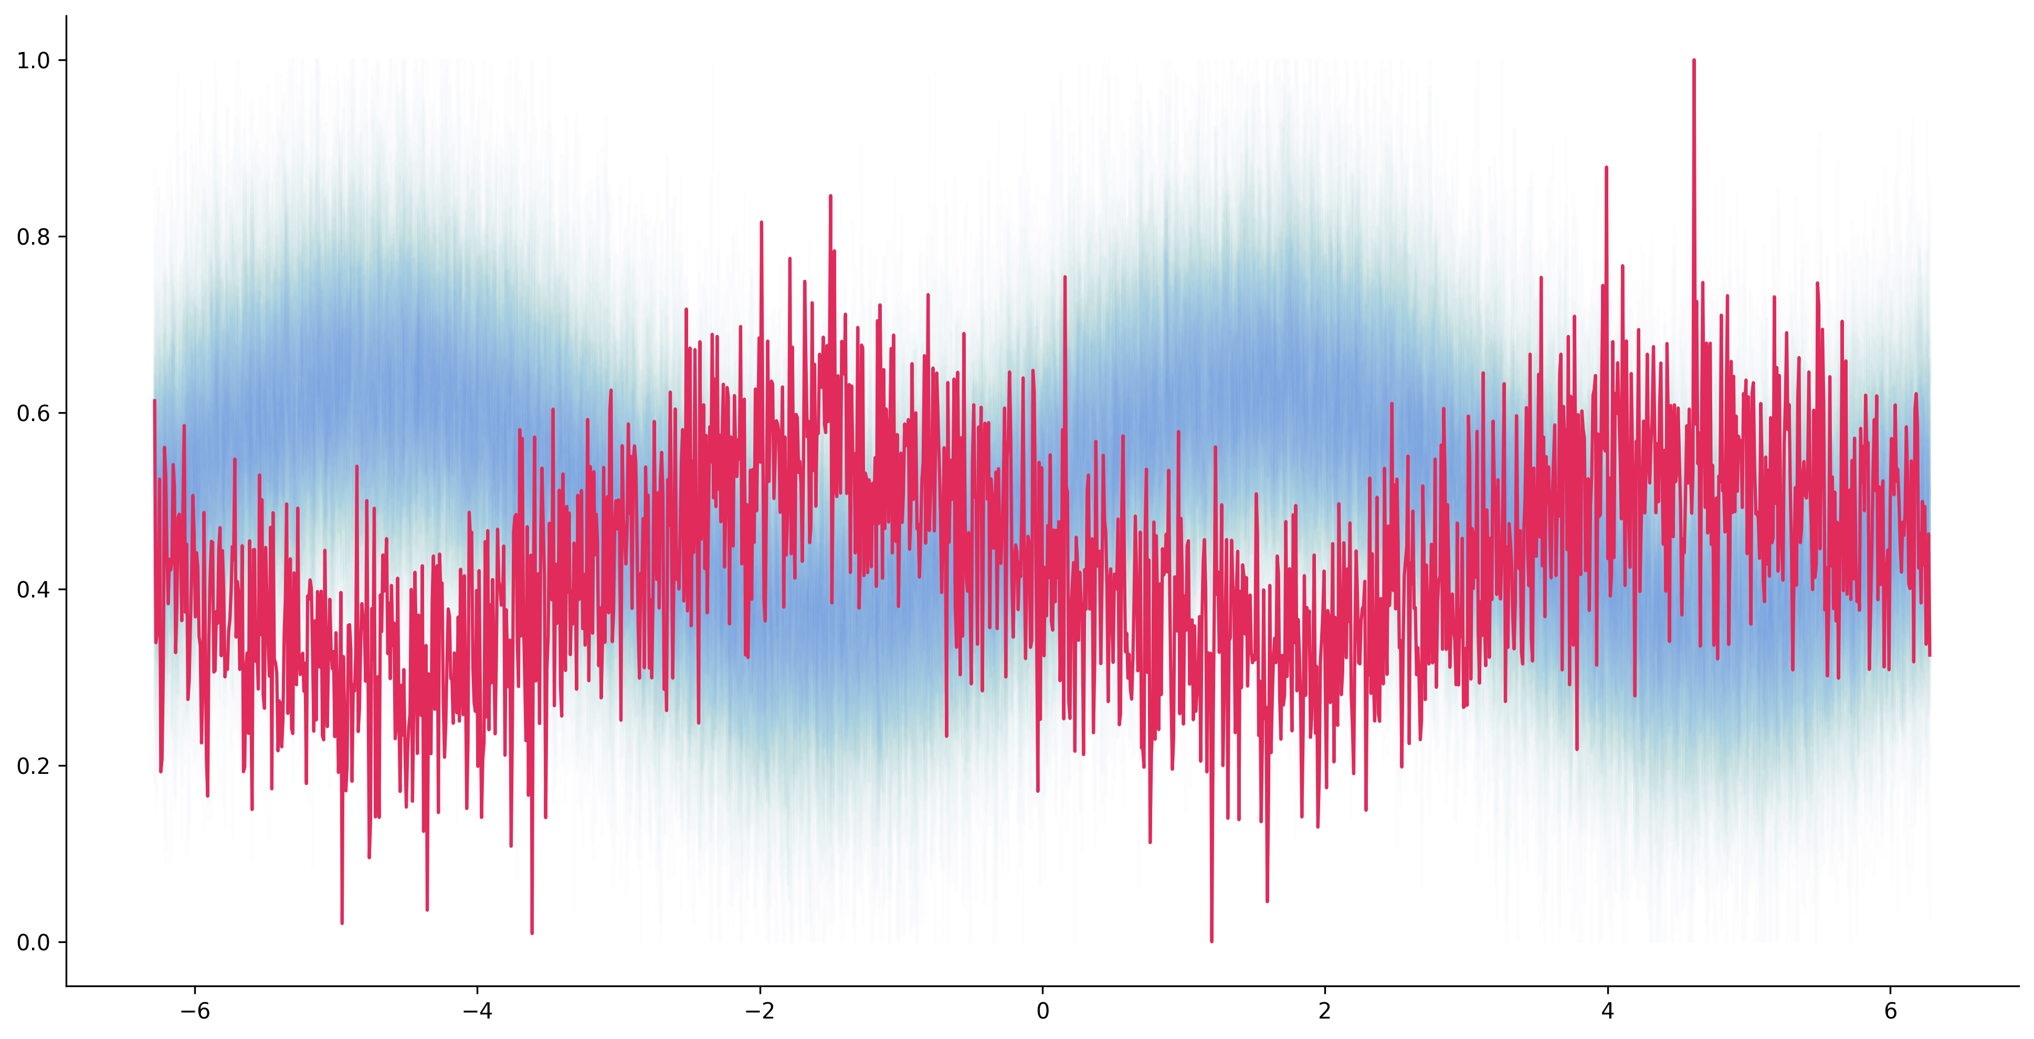
Success rates of clustering:
Direct K-means vs. Autoencoder ( )

Slide 19
Training dynamics
TODO: Put fancy training animation

Slide 20
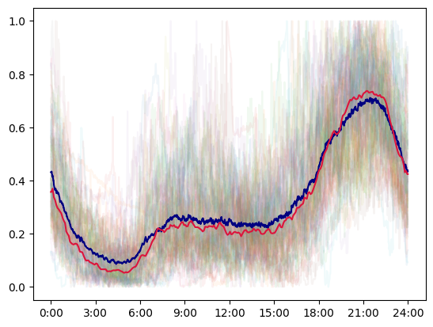
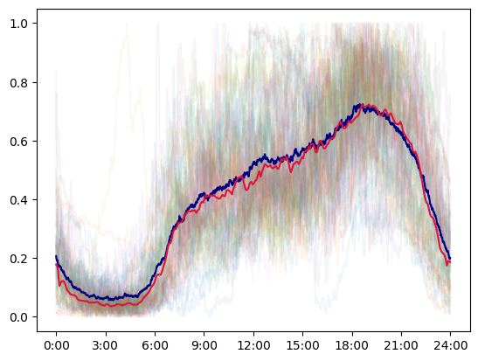
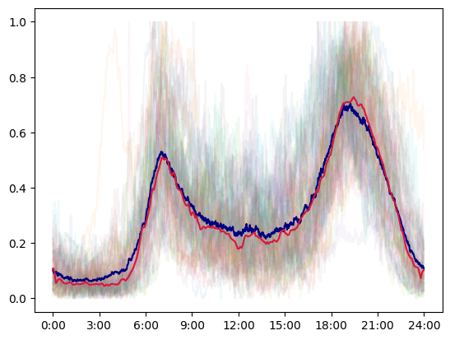
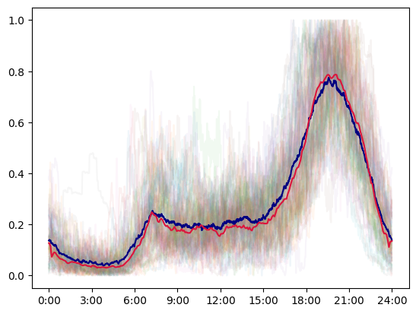
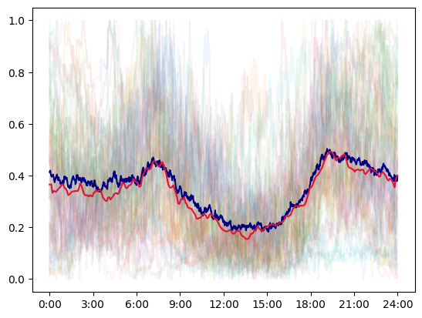
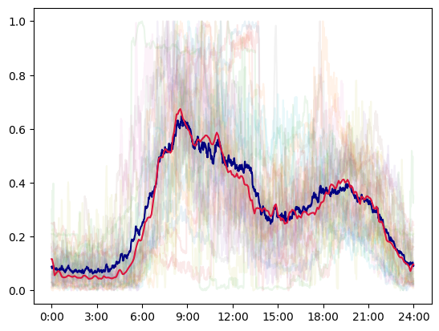
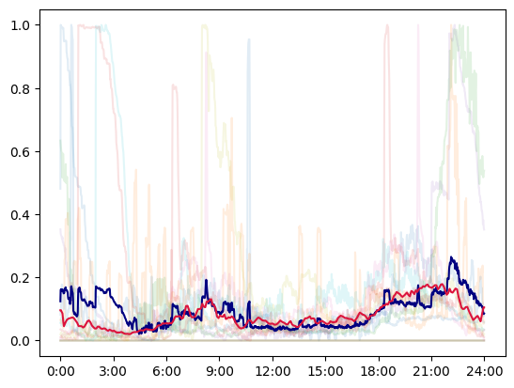
Results (k=7)
Cluster #1 (100)
Cluster #2 (100)
Cluster #3 (100)
Cluster #4 (100)
Cluster #5 (100)
Cluster #6 (100)
Cluster #7 (100)

Slide 21
How do the results compare against the naive K-means?

Slide 22
How do the results compare against the naive K-means?
Well...

Slide 23
Results comparison
TODO:

Slide 24
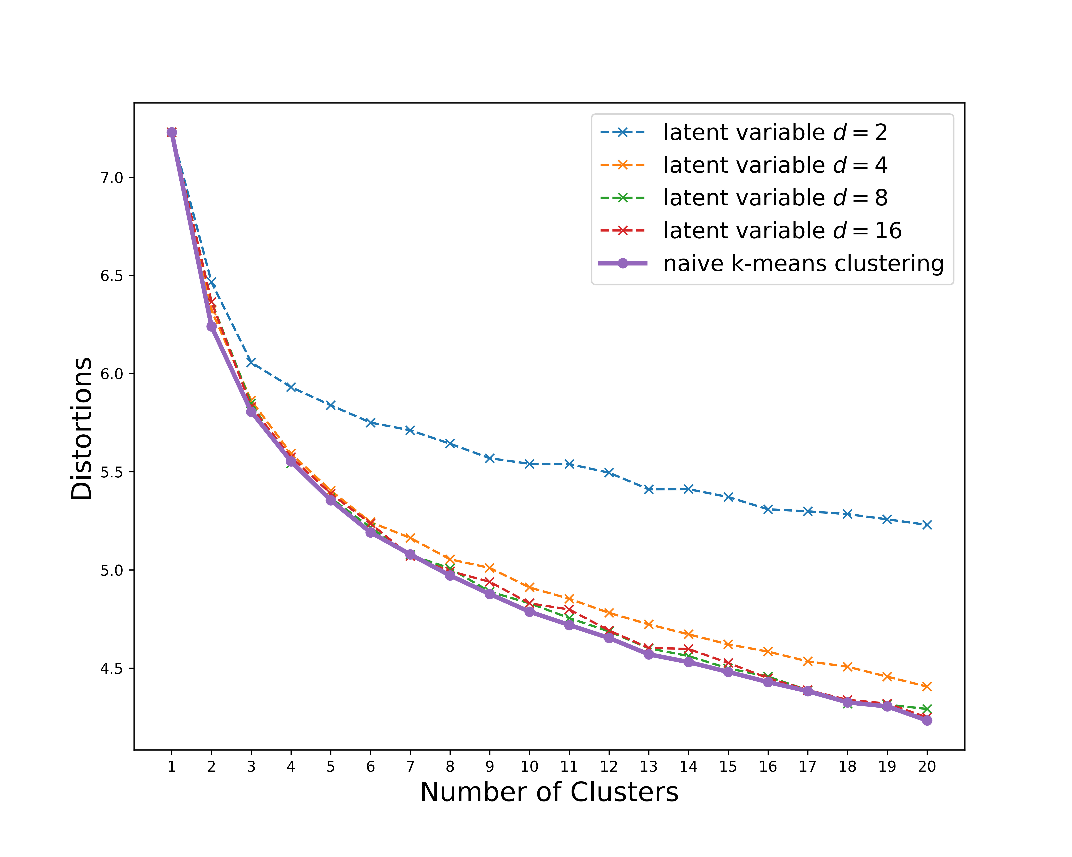
Results comparison (cont'd)

Slide 25
Why?

Slide 26
Curse of dimensionality, revisited
given

Slide 27
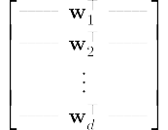
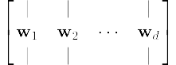
PCA is a linear autoencoder
first principal components

Slide 28
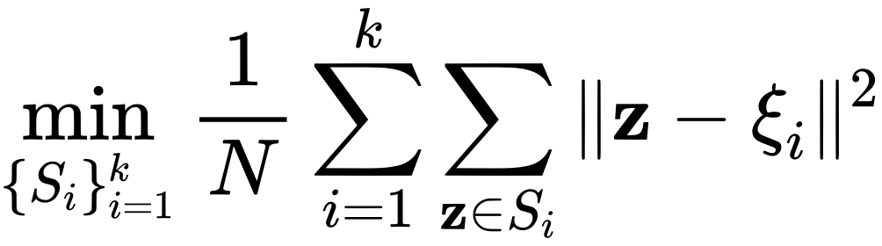
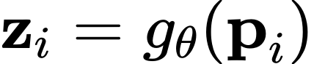
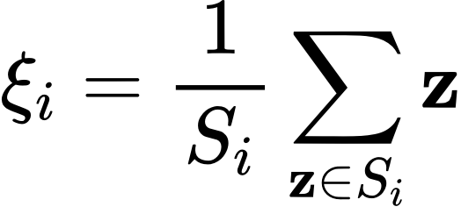
Problem Formulation (Cont'd)
Naive K-means
*Latent-space K-means

